Slide 1

RDBMS – MySQL PROJECT
Create Database scores
Import scores.csv to MySQL workbench
Visualize the table named as placements
4. Set primary key
5. Change the datatype of columns
6. SQL queries

Slide 2

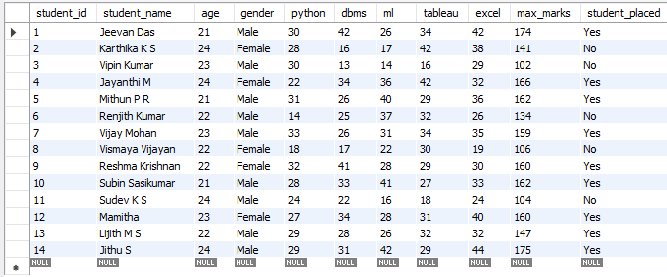

Slide 3
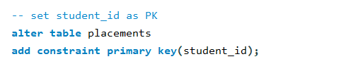
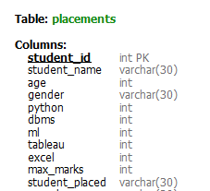

Slide 4
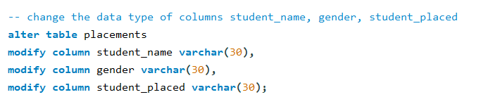

Slide 5

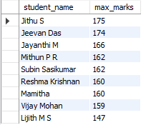

Slide 6

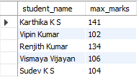

Slide 7



Slide 8


Slide 9
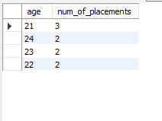

Slide 10
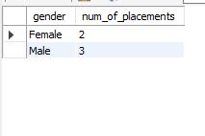

Slide 11


Slide 12
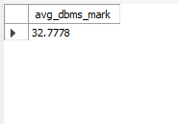

Slide 13


Slide 14
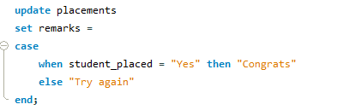
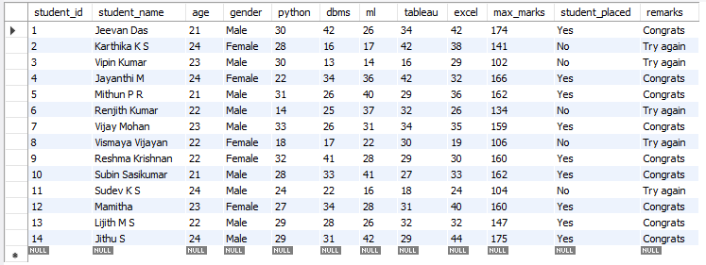

Slide 15
THANK YOU…

